Slide 1
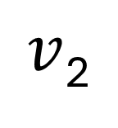
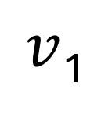
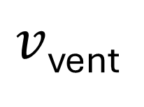
* Vent holes are located at flight computer disk in Case #2
A_{vent}
$v$_{vent}
V₂
Tracker Disk
$v$₂
A₂
V₃
$v$₁
L
A₁
V₁
Flight Computer Disk

